Slide 1

Multi-Behavior Recommendation with Cascading Graph Convolution Networks
in Proceedings of the ACM Web Conference 2023, in WWW ’23. New York, NY, USA
汇报人：袁巡
Notes:
Z. Cheng, S. Han, F. Liu, L. Zhu, Z. Gao, and Y. Peng, “Multi-Behavior Recommendation with Cascading Graph Convolution Networks,” in Proceedings of the ACM Web Conference 2023, in WWW ’23. New York, NY, USA: Association for Computing Machinery, Apr. 2023, pp. 1181–1189. doi: 10.1145/3543507.3583439.

Slide 2

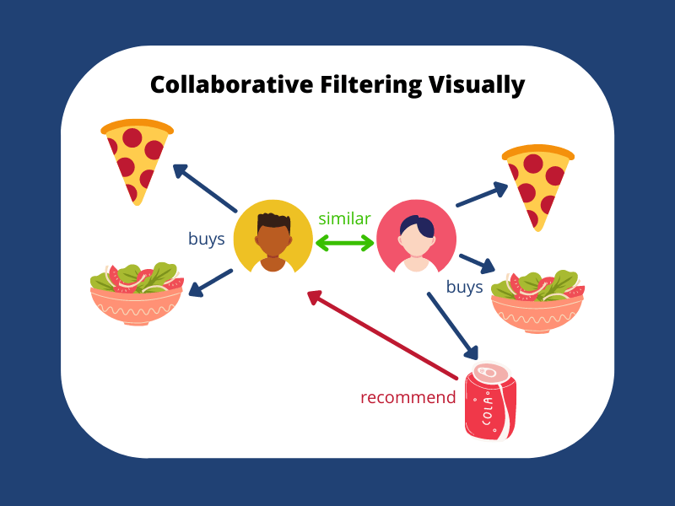
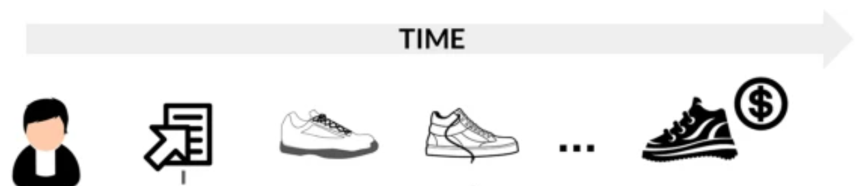
Research background
Data for a single behavior tends to be very sparse , which can affect the model's recommendation.
Click
View
Cart
Buy
Collaborative filtering models enable personalized recommendations by mining similarities between users and items
Integrating multiple user behaviors (e.g., clicking, adding to cart) into a collaborative filtering model can provide more data on user-item interactions
Multiple behaviors are usually performed in a certain order (e.g., click >cart > buy). In a behavioral chain, the latter behavior usually exhibits stronger user preference signals than the former. Most existing multi-behavior models fail to capture such dependencies in the behavior chain for embedded learning.
Tsinghua University of China
Central South University
Notes:
冷启动问题（新用户或新物品的推荐难度）、稀疏性问题（用户-物品评分矩阵非常稀疏）

Slide 3
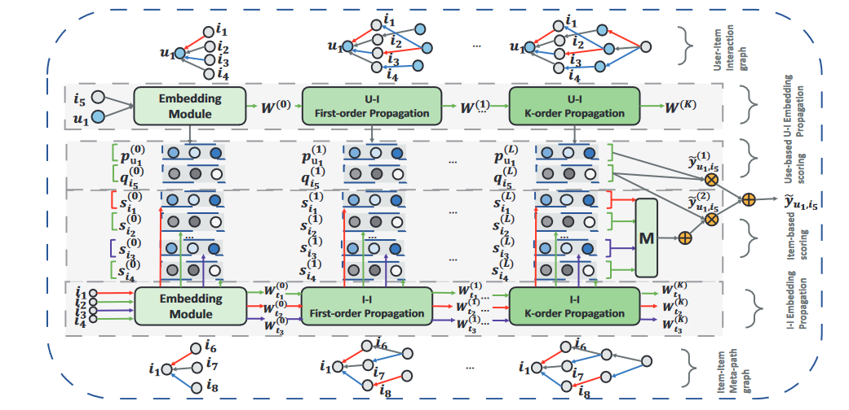
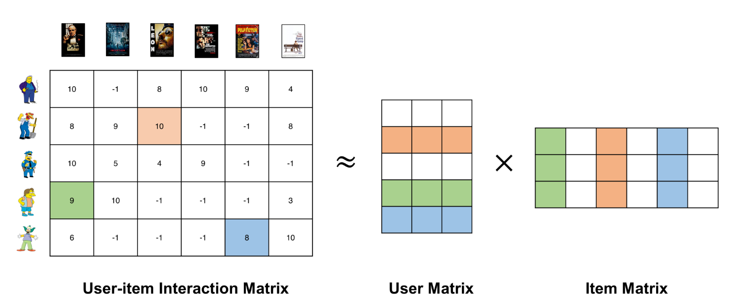
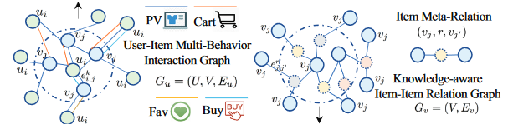
Related work
Traditional Methods:Based on traditional recommendation techniques, such as extending matrix factorization methods from single behavior to multi-behavior matrix decomposition
GCN-based Models: GCN models typically construct a unified graph based on all types of interaction behaviors and then perform GCN operations on the graph to learn user and item embeddings. Existing methods like GHCF and MBGCN adopt this strategy.
Deep Learning Approaches：MATN and KHGT employ Transformer networks to model multi-behavior relations and learn user/item embeddings.
Although some existing methods consider dependencies among multi-behaviors, most do not explicitly leverage these dependencies in the embedding learning process. Current models often ignore the order of behaviors, treating all auxiliary behaviors equivalently without modeling their sequential nature.
Tsinghua University of China
Central South University
Notes:
KHGT ：Lianghao Xia, Chao Huang, Yong Xu, Peng Dai, Xiyue Zhang, Hongsheng Yang, Jian Pei, and Liefeng Bo. 2021. Knowledge-Enhanced Hierarchical Graph Transformer Network for Multi-Behavior Recommendation. In Proceedings of the ThirtyFifth AAAI Conference on Artifcial Intelligence. AAAI Press, 4486–4493.
尽管已有一些方法考虑了多行为之间的依赖关系，但大多数方法仍未在嵌入学习中显式利用这些依赖关系。现有方法往往忽视了行为的顺序，只是简单地将所有辅助行为视为等同。

Slide 4
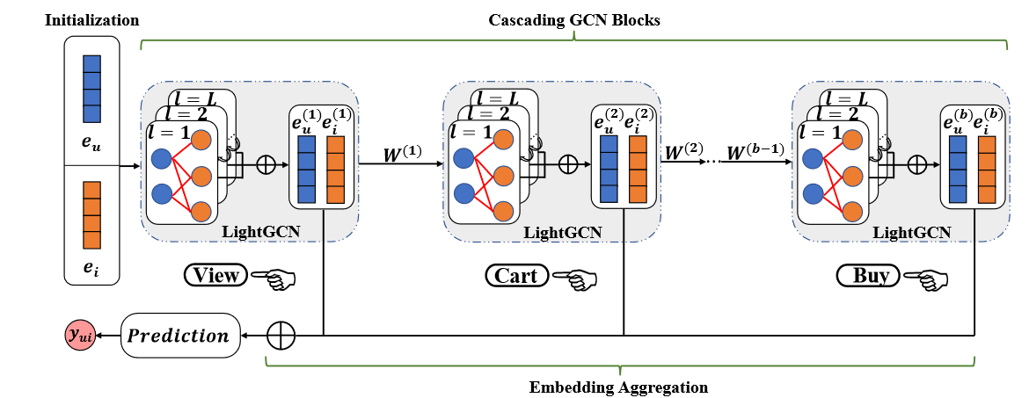
Contributions
1.They highlight the importance of exploiting the behavior dependencies in a behavior chain in multi-behavior recommendation and propose to distill the behavioral features of a former behavior to facilitate the embedding learning in the latter one.
2. They propose a novel multi-behavior recommendation model MBCGCN with a simple structure. It mainly consists of a sequence of GCN blocks, in which the embeddings learned in a previous GCN are processed by a feature transformation operation and then used as the input to the next one.
3.We comprehensively evaluate the efectiveness of MB-CGCN on two real-word datasets. Experiment results show that our model can signifcantly improve the recommendation performance with a large margin

Slide 5

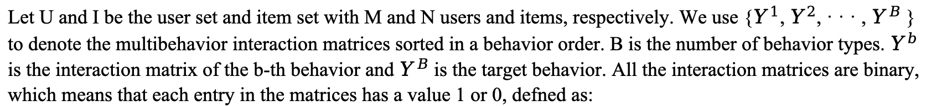
Problem Formulation
Let U and I be the user set and item set with M and N users and items, respectively. We use {$Y^{1}$, $Y^{2}$, · · · , $Y^{B}$ } to denote the multibehavior interaction matrices sorted in a behavior order. B is the number of behavior types. $Y^{b}$ is the interaction matrix of the b-th behavior and $Y^{B}$ is the target behavior. All the interaction matrices are binary, which means that each entry in the matrices has a value 1 or 0, defned as:
The task of multi-behavior recommendation is formulated as:
Input: {$Y^{1}$, $Y^{2}$, · · · , $Y^{B}$ }, for a user set U and an item set I.
Output: A recommendation model to predict the probability that a user u will interact with an item i under the B-th behavior, i.e., target behavior.
These auxiliary behaviors also contain rich information about user preferences and can be used to alleviate the data sparsity and cold-start issues. In this work, our goal is to design a recommendation model for the target behavior by exploiting the auxiliary behaviors.
Tsinghua University of China
Central South University
Notes:
这些辅助行为还包含丰富的用户偏好信息，可用于缓解数据稀缺和冷启动问题。在这项工作中，我们的目标是利用辅助行为为目标行为设计一个推荐模型。

Slide 6
Overview of MB-CGCN model.
1) Embedding initialization, which initializes user and item embeddings for the subsequent learning based on the behaviors in a defned order. 2) Cascading GCN blocks, in which LightGCN is adopted to learn the user and item embeddings for each behaviors. More specifcally, the embeddings learned from a previous behavior will be delivered to facilitate the next behavior’s embedding learning via a feature transformation. 3) Embedding aggregation, which aggregates the embeddings learned from each behavior for the target behavior prediction.
Tsinghua University of China
Central South University
Notes:
LightGCN 是一种图卷积网络（GCN）的变体，专为推荐系统而设计。它简化了传统 GCN 的架构，去除了特征变换和非线性激活函数，从而提高了训练效率和推荐质量。

Slide 7

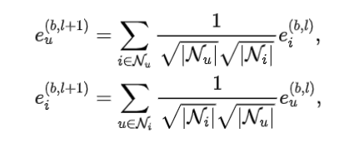

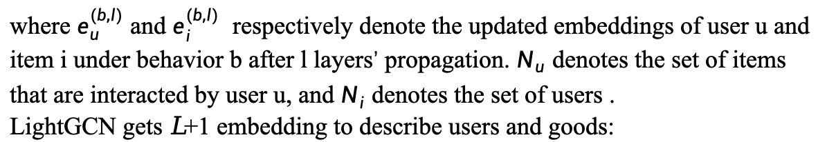
Methodology
Embedding Initialization.
where P and Q denote the embedding matrices of users and items, respectively; and ${ID}_{m}^{U}$ and ${ID}_{n}^{I}$ denote one hot vector matrix of all users and items, respectively. The initialized embeddings are used for the input features of users and items in LightGCN for the first behavior.
Cascading GCN blocks
The basic idea is to use cascaded LightGCNs to extract features from different behaviors and use dependencies in the chain of behaviors to help learn features for the latter behavior.
where $e_{u}^{(b,l)}$ and $e_{i}^{(b,l)}$ respectively denote the updated embeddings of user u and item i under behavior b after l layers’ propagation. $N_{u}$ denotes the set of items that are interacted by user u, and $N_{i}$ denotes the set of users .
LightGCN gets 𝐿 +1 embedding to describe users and goods:
Notes:
级联GCN块是我们模型的核心组件。该组件主要由一个LightGCN链组成，其中每个LightGCN响应一种类型的行为来学习该行为的用户和物品嵌入。与链一起，从上一个LightGCN中学习到的嵌入在特征转换操作后被用作下一个LightGCN中用户和物品的输入特征。基本思想是使用级联LightGCN从不同的行为中提取特征，并利用行为链中的依赖关系来帮助学习后一种行为的特征。
层间传播规则+嵌入层聚合

Slide 8

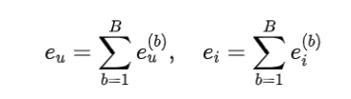


Methodology
Feature Transformation.
Considering that directly using the features of the previous behavior as the initialization embedding can be seen as refining the embedding using the latter behavior, which may lose the different information conveyed by different behaviors. On the other hand, the noisy information in the former behavior can seriously affect the learning process of the latter behavior. Based on this consideration, we introduce a feature transformation design in MB-CGCN to process the learned embeddings before delivery.
where $W_{u}^{b}$ and $W_{i}^{b}$ respectively denote the transformation vector for user u and item i. $e_{u}^{(b+1,0)}$ and $e_{i}^{(b+1,0)}$ denote the initial embeddings.
Embedding Aggregation.
Use linear combinations to aggregate features learned from different behaviors (similar to the LightGCN aggregation method mentioned above)
The final prediction score is
Using the standard BPR loss, the objective function expression is:
Notes:
考虑到直接使用前一个行为的特征作为初始化嵌入可以看作是使用后一个行为对嵌入进行了细化，这可能会丢失不同行为所传递的不同信息。另一方面，前一种行为中的噪声信息会严重影响后一种行为的学习过程。基于此考虑，我们在MB-CGCN中引入了特征转换设计，在交付之前对学习到的嵌入进行处理。
保留不同行为间的信息差异：通过特征转换，可以保留每种行为所传递的独特信息，同时去除不必要的噪音。
使用最终的用户和项目嵌入计算预测评分，通常是通过嵌入的内积来实现，
BPR（Bayesian Personalized Ranking）损失是一种在推荐系统中常用的优化目标

Slide 9
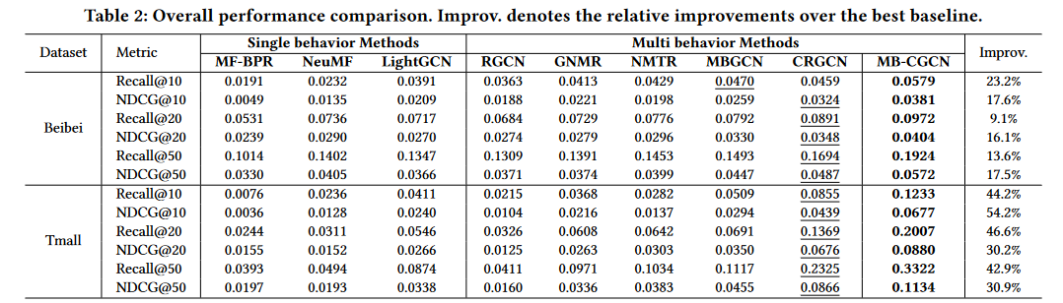
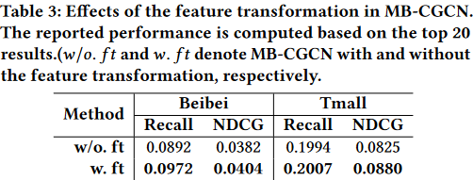
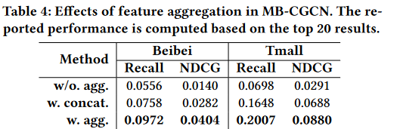
Experiment
Multi-behavioral models can achieve better performance than single-behavioral models, demonstrating the benefits of using auxiliary behaviors (i.e., viewing and shopping carts) for the prediction of target behaviors (i.e., purchases).
Through feature transformation, MB-CGCN on BeiBei rRecall@20 and NDCG@20 The relative improvement rates are 9.0% and 5.8%, respectively, and the relative improvement rates on Tmall are 0.7% and 6.7%, respectively. The results demonstrate the effectiveness of feature transformation schemes in extracting useful information from early behaviors to assist in learning user and item embeddings in later behaviors.
Tsinghua University of China
Central South University
Notes:
我们将MB-CGCN与基线之间的性能比较。从结果中，我们可以看到，多行为模型可以比单一行为模型获得更好的性能，展示了利用辅助行为(即查看和购物车)对目标行为(即购买)预测的好处。 通过特征变换，MB-CGCN在BeiBei上rRecall@20和NDCG@20的相对提高率分别为9.0%和5.8%，在天猫上的相对提高率分别为0.7%和6.7%。结果证明了特征转换方案在从早期行为中提取有用信息以帮助学习后期行为中的用户和物品嵌入的有效性。

Slide 10
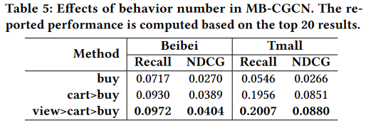
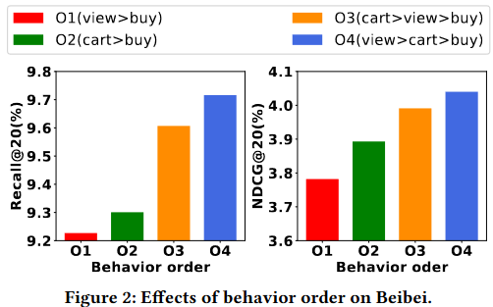
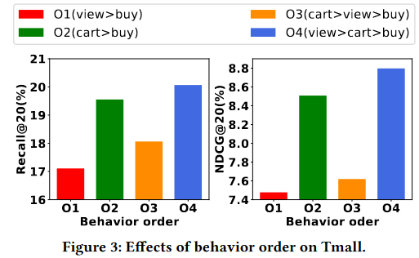
Experiment
Apparently, with more types of behaviors, our model performs better. Interestingly, with the use of cart data, the performance is improved by a large margin; with the further consideration of view data, the improvement becomes smaller.
。
On both datasets, O4 outperforms O3, demonstrating the importance of modeling multiple behaviors in the correct order, which is consistent with the common behavioral order in real-world applications.
The model with 03 on TMC performs worse than the model with 02.Due to the cascade design of the model, the embedding learned from the previous behavior will directly influence the embedding learning in the next behavior.
Tsinghua University of China
Central South University
Notes:
在两个数据集上，O4的性能都优于O3，证明了以正确的顺序对多行为建模的重要性，这与现实应用中的常见行为顺序保持一致。
视图数据中的噪声信息会对目标行为中的嵌入学习产生负面影响，而目标行为的特征在最终的预测中起着重要作用。这进一步说明了行为顺序在多行为级联建模中的重要性。

Slide 11
CONCLUSION
1. We can learn how to integrate behavioral chains into the network, where embeddings learned from one behavior are used as input features for the next behavioral embedding learned through feature transformation
2.Think about the differences in behavior in a network scenario versus a recommendation scenario. The behavior of nodes in a network will be more varied and not necessarily have stronger dependencies
3.There are fewer references to papers that consider behavioral chains, and most of them consider multi-behavioral recommendation tasks in recommendation tasks
4. How to define behaviors and behavioral chains in the network. How to reflect the behavior and behavior chain in the experiment, there are more difficulties in the experiment
Tsinghua University of China
Central South University
Notes:
1.我们可以学习如何集成行为链到网络，从一个行为中学习到的嵌入通过特征转换作为下一个行为嵌入学习的输入特征
2.思考网络场景与推荐场景中行为的不同。网络中的节点行为会更多，也不一定存在较强的依赖关系
3.考虑行为链的论文参考较少，在推荐任务中，大部分都是考虑多行为推荐任务
4.如何定义行为，定义行为链，如何在实验当中体现行为和行为链，实验当中的困难比较多 时间维度上 矢量 空间维度上 微服务中任务链 任务链的表征方法 直接借鉴 怎么表征
残差 网络领域里行为 定义和表征 节点加入 节点断开 节点拒绝 实验当中

Slide 12
Thanks for listening！

